Slide 1
13–4 DISK MEMORY SYSTEMS
Disk memory is used to store long-term data.
Many types of disk storage systems are available and they use magnetic media.
except optical disk memory that stores data on a plastic disk
Optical disk memory is either:
CD-ROM (compact disk/read only memory) which read, but never written
WORM (write once/read mostly), read most of the time, but can be written once by a laser

Slide 2
Optical disk memory that can be read and written many times is becoming available.
there is still a limitation on the number of write operations allowed
The latest optical disk technology is called DVD (digital-versatile disk).
also available in high-resolution versions for video and data storage as Blu-ray (50G) or HD-DVD (30G)

Slide 3
Floppy Disk Memory
The floppy, or flexible disk was once the most common and basic form of disk memory.
the floppy is beginning to vanish and may disappear shortly in favor of the USB pen drive
Floppy disk magnetic recording media have been made available in three sizes:
8″ standard
5¹/₄″ mini-floppy
3¹/₂″ micro-floppy.

Slide 4
All disks have several things in common.
They are all organized so that data are stored in tracks and sectors.
a track is a concentric ring of data stored on the surface of a disk
a sector is a common subdivision of a track designed to hold a reasonable amount of data
In many systems, a sector holds either 512 or 1024 bytes of data.
size of a sector can vary from 128 bytes to the length of one entire track

Slide 5
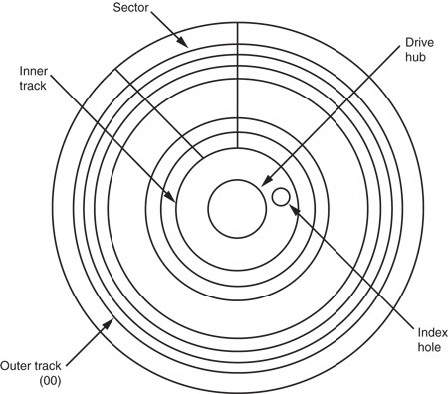
Figure 13–18 The format of a 5¹/₄″ mini-floppy disk.
the index hole is so the system can find the start of a track and first sector (00)
tracks are numbered from track 00, the outermost track, toward the center
sectors are often numbered from sector 00 on the outermost track

Slide 6
The 5 ¹/₄″ Mini-floppy Disk
The 5¹/₄″ floppy is very difficult to find and is used only with older microcomputer systems.
The floppy disk is rotated at 300 RPM inside its semi-rigid plastic jacket.
the head mechanism in a floppy drive makes physical contact with the surface of the disk, which causes wear and damage to the disk
Most mini-floppy disks are double-sided.
data are written on the top & bottom surfaces

Slide 7
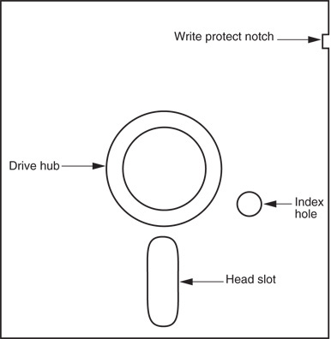
Figure 13–19 The 5¹/₄″ mini-floppy disk.
a set of tracks called a cylinder consists of one top and one bottom track
Cylinder 00 consists of the outermost top and bottom tracks

Slide 8
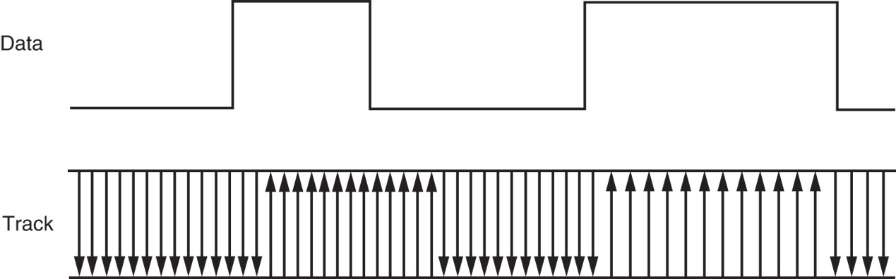
Figure 13–20 The non-return to zero (NRZ) recording technique.
the magnetic recording technique used to store data on the surface of the disk is called non-return to zero (NRZ) recording
with NRZ recording, magnetic flux placed on the surface of the disk never returns to zero
arrows show the polarity of the magnetic field stored on the surface of the disk

Slide 9
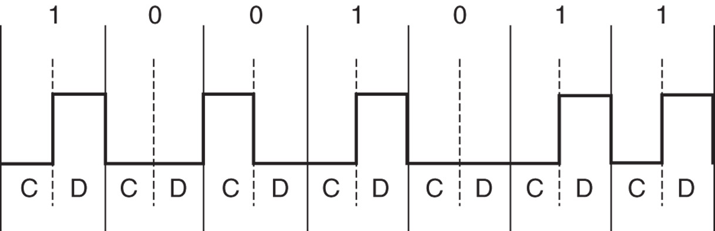
Figure 13–21 Modified frequency modulation (MFM) used with disk memory.
data are stored in the form of MFM (modified frequency modulation) on modern floppy disks
each bit time is 2.0 µs wide on a double-density disk
data are recorded at the rate of 500,000 bits per second

Slide 10
The 3 ¹/₂″ Micro-Floppy Disk
A much improved version of the mini-floppy disk described earlier.
The micro-floppy is packaged in a rigid plastic jacket that will not bend easily.
a much greater degree of protection to the disk
The head door remains closed until the disk is inserted into the drive.
once in the drive, the mechanism slides open the door, exposing the surface of the disk to the read/write heads

Slide 11
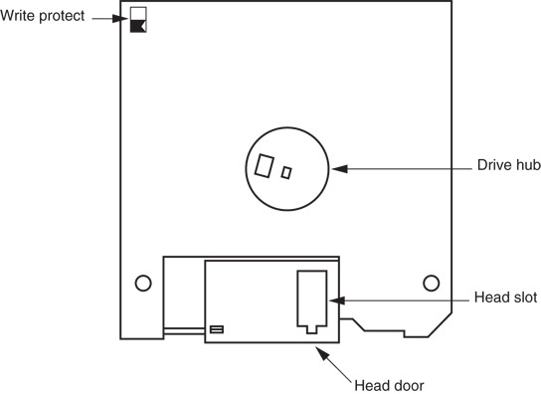
Figure 13–22 The 3¹/₂″ micro-floppy disk.

Slide 12
On the mini-floppy, a piece of tape was placed over a notch on the side of the jacket to prevent writing.
this plastic tape easily became dislodged inside disk drives, causing problems
The micro-floppy has an integrated plastic slide replacing the tape write-protection.
To write-protect (prevent writing) the micro-floppy disk, the plastic slide is moved to open the hole through the disk jacket.
allows light to strike a sensor that inhibits writing

Slide 13
Pen Drives
Pen drives, or flash drives use flash memory to store data.
a driver treats the pen drive as a floppy with tracks and sectors, though it really does not
The FAT system is used for the file structure.
memory in this type of drive is serial memory
When connected to the USB bus, the OS recognizes it and allows data to be transferred between it and the computer.

Slide 14
Hard Disk Memory
Hard disk memory has a much larger capacity than the floppy disk memory.
often called a fixed disk because it is not removable like the floppy disk
A hard disk is also often called a rigid disk.
the term Winchester drive is also used, but less commonly today
Common, low-cost (less than $1 per gigabyte) sizes are presently 20G bytes to 500G bytes.
sizes approaching 1 T (tera) bytes are available

Slide 15
The hard disk memory uses a flying head to store and read data.
A flying head, which is very small and light, does not touch the surface of the disk.
it flies above the surface on a film of air that is carried with the surface of the disk as it spins
The hard disk typically spins at 3000 to 15,000 RPM, many times faster than a floppy.
higher rotational speed allows the head to fly just over the top of the surface of the disk
There is no wear on the hard disk’s surface.

Slide 16
Problems can arise because of flying heads.
if power is interrupted or the drive is jarred, the head can crash onto the disk surface, which can damage the disk surface or the head
Some drive manufacturers have included a system to automatically park the head when power is interrupted.
when the heads are parked, they are moved to a safe landing zone (unused track) when power is disconnected

Slide 17
Another difference between a floppy and a hard drive is the number of heads and disk surfaces.
a floppy has two heads, one for the upper surface and one for the lower surface
the hard drive has up to eight disk surfaces (four platters), with up to two heads per surface
Each time a new cylinder is obtained by moving the head assembly, 16 new tracks are available under the heads.
See Figure 13–23.

Slide 18
Heads are moved from track to track by using either a stepper motor or a voice coil.
the stepper motor is slow and noisy; moving the head assembly requires one step per cylinder
the voice coil mechanism is quiet and quick; the heads can be moved many cylinders with one sweeping motion
Stepper-motor-type head positioning mechanisms can become misaligned
while the voice coil mechanism corrects for any misalignment

Slide 19
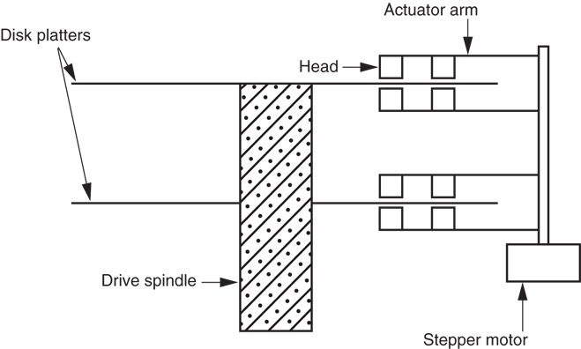
Figure 13–23 A hard disk drive that uses four heads per platter.

Slide 20
Hard drives often store information in sectors that are 512 bytes long.
Data are addressed in clusters of eight or more sectors, which contain 4096 bytes (or more) on most hard disk drives.
All hard drives use today RLL encoding.

Slide 21
RLL Storage
The term run-length limited (RLL) means the run of zeros (zeros in a row) is limited.
a common RLL encoding scheme is RLL 2,7, which means the run of zeros is always between two and seven
An RLL drive often contains 27 tracks instead of the 18 found on the MFM drive.
Fig 13–24 is a comparison of MFM & RLL.
besides holding more information, the RLL drive can be written and read at a higher rate

Slide 22
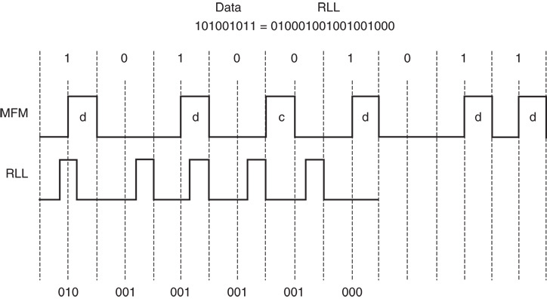
Figure 13–24 A comparison of MFM with RLL using data 101001011.

Slide 23
There are a number of disk drive interfaces in use today.
the oldest is the ST-506 interface, which uses either MFM or RLL data
Newer standards are in use today.
which include ESDI, SCSI, and IDE
The IDE system is becoming the standard hard disk memory interface.
The enhanced small disk interface (ESDI) system is capable of transferring data at rates approaching 10M bytes per second.

Slide 24
ST-506 interface approaches 860K bytes/sec.
The small computer system interface (SCSI) allows up to seven different disk or other interfaces to be connected to the computer through same interface controller.
SCSI is found in some PC-type computers and also in the Apple Macintosh system
An improved version, SCSI-II, has started to appear in some systems.
in the future, this interface may be replaced with IDE in most applications

Slide 25
One of the most common systems is the integrated drive electronics (IDE) system.
incorporates the disk controller in the drive and attaches to the host system through a small interface cable
IDE drives are found in newer IBM PS-2 systems and many clones.
even Apple computer systems are starting to be found with IDE drives
The IDE interface is also capable of driving other I/O devices besides the hard disk.

Slide 26
IDE usually contains at least a 256K- to 8M-byte cache memory for disk data.
the cache speeds disk transfers
Access times for an IDE drive are often less than 8 ms.
access time for a floppy-disk is about 200 ms
IDE is also called ATA, an acronym for AT attachment where “AT” means the Advanced Technology computer.

Slide 27
The latest is the serial ATA interface or SATA.
this interface transfers serial data at 150 MBps (or 300 MBps for SATA2), faster than IDE
Not yet released is SATA3, which transfers data at a rate of 600 MBps.
The transfer rate is higher because the logic 1 level is no longer 5.0 V. It is now 0.5 V.
which allows higher data transfer rates because it takes less time for the signal to rise to 0.5 V than to 5.0 V

Slide 28
Optical Disk Memory
Optical disk memory is commonly available in two forms:
CD-ROM (compact disk/read only memory)
WORM (write once/read mostly)
CD-ROM is the lowest cost, but suffers from lack of speed.
access times are typically 300 ms or longer
As systems develop and become more visually active, use of the CD-ROM drive will become even more common.

Slide 29
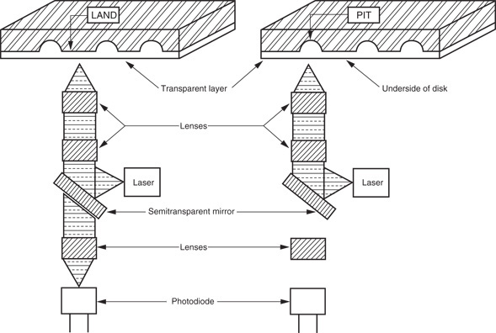
Figure 13–25 The optical CD-ROM memory system.

Slide 30
The WORM drive sees far more commercial application than the CD-ROM.
application is very specialized due to its nature
WORM is normally used to form an audit trail of transactions spooled onto the WORM and retrieved only during an audit.
one might call the WORM an archiving device
The advantage of the optical disk is durability.
About the only way to destroy data on an optical disk is to break it or deeply scar it.

Slide 31
The new versatile read/write CD-ROM, called a DVD, became available in the mid 1990’s.
New to this technology are the Blu-ray DVD from Sony Corporation and the HD-DVD from Toshiba Corporation.
Blu-ray DVD capacity is 50 GB; HD-DVD, 30 GB
The big change from older DVDs is a switch from a red laser to a blue laser.
a blue laser has a higher frequency, which means it can read more information per second from the DVD, hence a high storage density

